Slide 1
Annual Interagency Accessibility Forum
Accessibility: A Foundation for Inclusion, Diversity, and Equity
October 12-14, 2021
Designing to Support People with Cognitive and Learning Disabilities
Rachael Bradley Montgomery, PhD

Slide 2

Introduction: Rachael Bradley Montgomery
Accessibility Related Roles
Digital Accessibility Specialist at the Library of Congress
Co-Chair W3C Accessibility Guidelines Working Group
Editor
WCAG 2.2
Making Content Usable
WCAG 3.0
Executive Director of Accessible Community
Affiliate Faculty at UMD Trace Research Center
Disclaimer
This talk represents my personal views on the topic and not any official view of any affiliated organizations.

Slide 3
Objectives
Humanize and diversify ”cognitive and learning disabilities”
Introduce design patterns that support people with cognitive and learning disabilities
Provide ways to learn more about this topic
Notes:
If you leave twith a better understanding of the diverse needs of people with cognitive and learning disabilities and next steps for designing to support them, then this talk is successful.

Slide 4
Agenda
Background
Personas and Design Patterns
Plain Language
Questions

Slide 5
Functional Needs: Cognitive & Learning Disabilities
Functional Need (Use with Limited…) | Example Disabilities with these Needs
Attention | Attention Deficit (Hyperactivity) Disorder
Language and Literacy | Aphasia, Dyscalculia
Learning | Brain Injury, Dyslexia
Memory | Age Related Forgetfulness, Mild Cognitive Impairment
Executive | Brain Injury, Autism
Mental Health | Anxiety, Post Traumatic Stress Disorder
Link: DRAFT Functional Needs
Notes:
With Cognitive and Learning Disabilities there is not:
Universal language used to categorize disabilities
Clear one-to-one mapping between disability and needs
Traditionally the accessibility profession has grouped this category together but it is every bit as diverse as physical disabilities. In some ways, it is the category of “we aren’t quite sure how to measure accessibility well here”
Attention
Use with limited ability to focus attention
Use with limited ability to direct attention
Use with limited ability to shift attention
Language & Literacy
Use without ability to read
Use with limited ability to recognize written language
Use with limited ability to comprehend written language
Use without ability to write
Use with limited ability to correctly write (or type) words and use punctuation
Use without understanding symbols
Use without understanding metaphors, idioms, euphemisms, or specific dialect of culture or location
Learning
Use with limited ability of math and numeric concepts
Use with limited compositional skill (simultaneous thinking and input)
Use with limited coordinational skill (motoric skills, visual-spatial organizational memory, and social)
Memory
Use with limited short-term or working memory
Use with limited medium or long-term memory
Use with limited sensory memory
Visual
Visuo-spatial
Auditory
Executive
Use with limited planning, organization, sequencing, and execution ability
Use with limited emotional control and self monitoring
Use with limited judgement
Mental Health
Use with debilitating fear or anxiety

Slide 6

Related Situational or Temporary Disabilities
Fatigue
Stress
Distraction
Using foreign languages or measurements

Slide 7
Making Content Usable
Objectives
Help Users Understand What Things are and How to Use Them
Help Users Find What They Need
Use Clear and Understandable Content
Help Users Avoid Mistakes and Know How to Correct Them
Help Users Focus
Ensure Processes Do Not Rely on Memory
Provide Help and Support
Support Adaptation and Personalization
Link: Making Content Usable for People with Cognitive & Learning Disabilities
Notes:
Informational Document Only
In document form to make it easy to move the information but a web form is almost ready for release that makes navigating the contents much easier.

Slide 8

Alison: Aging User with Mild Cognitive Impairment
Problem: I’m not sure what I should press. I pressed something that looked like the “buy” button but it did nothing. I am not sure if it is me or if this web site just doesn’t work.
Works well: The “buy” button was clearly something I could click. The process was easy. I have now bought matching dresses for all the grandchildren.
Sample User Needs
Use a familiar hierarchy and design
Use a consistent visual design
Clearly identify controls and their use
Make the relationship clear between controls and the content they affect
Provide human help
Make it easy to find help and give feedback
Notes:
Her Story
Alison has a medical background, working in rehabilitation of physical injuries.
She recently decided to work part-time to take up more hobbies and be with her grandchildren.
She wants to try an online course to learn Chinese, in preparation for a special holiday. Alison considers 63 to be the new 36. However, she has difficulty concentrating and finding the word she wants to say.
She often makes typos and has to correct sentences when she re-reads them. She becomes easily frustrated as she finds new technical things, like updated design patterns and applications, hard to learn and less intuitive than they used to be.
Plus, navigation takes longer than in the past.
Unfortunately, this includes learning how to use a new interface and this affects the way she works when swapping between her tablet, phone, and computer.
Mild Cognitive Impairment (MCI) can involve problems with memory, language, thinking, and judgment that are greater than normal age-related challenges. It is sometimes considered the stage between the common and expected age related forgetfulness and the more serious decline of dementia, although many or most people with MCI will not develop dementia.

Slide 9
Make the relationship clear between controls and the content they affect
The relationship between controls and affected content should be completely clear and unambiguous.
This can be achieved through:
visually grouping controls with the content they relate to,
including controls within the region they affect,
using clear dividers or white space between regions in a page that may have separate controls or a scroll bar,
avoiding multiple or nested scrolling area
Notes:
Use:
Controls clearly associated with the section they control. Place the control inside the section, and have clear borders around the section. Label the controls to match the section heading. For example:
On a library site, a search box for the whole site is located in the upper right of the site’s main navigation. A second search box searches the library catalog. It is located within a section with a clear border, different background color, and a heading “Library Catalog”. The go button reads “search catalog”.
A page needs a scrollbar for one section. The scrollbar look like it is inside the section.
Avoid:
Multiple scrollable sections where it is unclear which scrollbar to use for each section.
Controls for one section that look like they might affect the whole page or another section. For example: The search box relates to one area of a page, and not for another area. It is unclear which area the search is for.
Multiple nested scrolling regions.

Slide 10
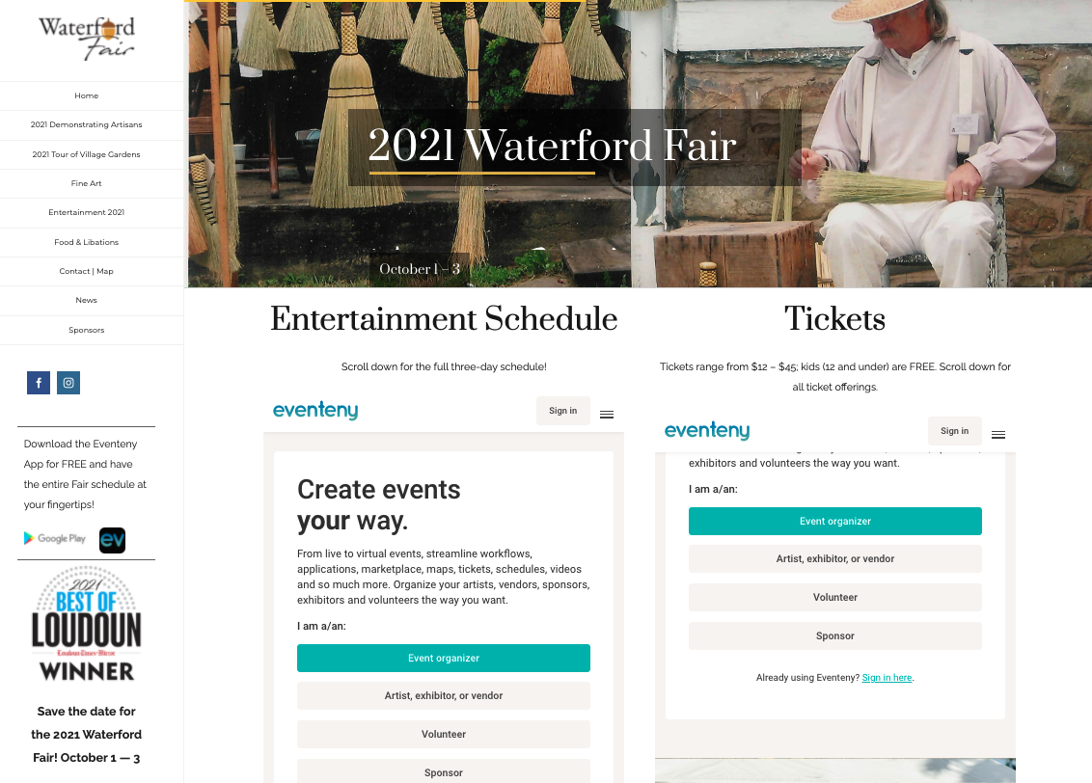
Example Waterford Fair (1/2)
Notes:
https://www.waterfordfairva.org/

Slide 11
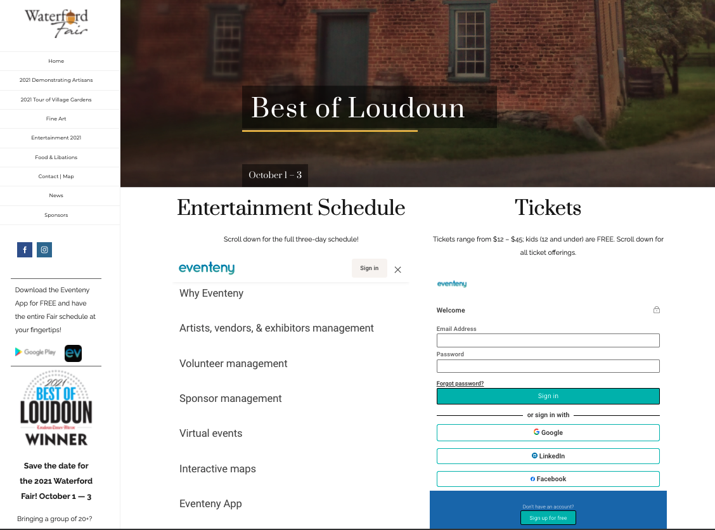
Example Waterford Fair (2/2)

Slide 12

Amy: Autistic Computer Scientist
Problem: Sometimes people use lots of words on web site links that do not seem to make sense. I think they are metaphors, but I’m not sure.
Works well: I put my mouse over items I do not understand and there is some clear text that explains what it did. I would rather they use clear text in the first place then at least I can use it.
Sample User Needs:
Separate each instruction
Use white spacing
Ensure foreground content is not obscured by background
Use Literal Language
Explain Implied Content
Notes:
Her Story
Amy loved her computer science course and now programs in several languages.
She has discovered she can visualize the outcome of her coding and is quick to find any errors even if they are not highlighted.
Writing documentation is less fun and she is too concise.
This means some users do not receive enough help using her applications.
Amy is always concerned about communicating clearly. She finds it hard when people ask her to create a design that includes abstract imagery. Images that do not directly represent something make Amy feel uneasy. She tends to ask if there can be some explanatory text in case other users are confused. Figures of speech where someone has written something that is not literal make her wish that the writer would use easy to understand language as it is hard to understand concepts such as, "the wheels of justice turn slowly".

Slide 13

Explain Implied Content
Provide definitions or explanations for implied or ambiguous information such:
body gestures,
emotions,
jokes,
sarcasm,
metaphors and simile, and
facial expressions
Everyone feels like they are working hard but not making progress.
Notes:
These definitions and explanations should be provided in text close to the implied content or in the markup.
Example:
If you are experiencing cold feet before starting, take a deep breath and jump in.
If you are experiencing anxiety before starting, take a deep breath. Tell yourself you can do it and get started. Anxiety can include nervousness, fear, dizziness, or shortness of breath.

Slide 14

A Challenge
Take 1 day and pay close attention to how much implied content you use and interact with – you will be surprised!

Slide 15

George: User with Down Syndrome, Works in Market
Problem: I find it hard to understand and remember long and complex written instructions.
Works well: The instructions for scanning items are presented as a clear list of steps with pictures and easy to understand language next to them. If I get stuck I can quickly find a reminder of what to do with such ‘Easy to Understand’ content.
Sample User Needs:
Use icons that help the user
Support a personalized and familiar interface
Provide alternative content for complex information and tasks
Enable APIs and extensions
Notes:
His Story
George enjoys his job and lives semi-independently in a small town, where he can easily find his way around.
However, George finds it hard to use search engines and navigate around web sites because of the need to work with large blocks of text.
He has problems using the online systems at work, and needs help to search for suitable videos or music.

Slide 16
Support a Personalized and Familiar Interface
Provide users with a way to personalize their interface to make it familiar. This can be done by:
Allowing user preferences on presentation such as font style, font size, line heights, margins, and contrast.
Allowing a rollback to a previous interface that the user is familiar with and knows how to use.
Adding semantics on controls, links, and symbols that allow the user to control the experience.
Ensure the user knows the personalization options and can easily configure them. Clear instructions can help.
Notes:
Use:
[HTML5] autocomplete tags on all common fields.
True text to support browser preferences for styles.
A toolbar that adds personalized images.
Semantics that can work with a toolbar for personalized images or [personalization-semantics-1.0].
Avoid:
Forms that do not support [HTML5] autocomplete.
Default fonts that are not clear or readable such as a cartoon font or gothic.
Pages that cannot easily be personalized.

Slide 17

Gopal: Retired Lawyer with Dementia
Problem: I want to turn the volume up but there is no dial?
Works well: There is a clear volume button with a label that makes sense, so I know what to press.
Sample User Needs:
Design forms to prevent mistakes
Use clear visible labels
Accept different input formats
Avoid data loss and “timeouts”
Notify users of fees and charges at the start of a task
Help the user stay safe
Use familiar metrics and units
Provide information so a user can complete and prepare for a task
Clearly state the results and disadvantages of actions, options, and selections
Notes:
His Story
Gopal retired from his law firm in his early 60s when he found he was forgetting important items that needed to be discussed in his complex caseload.
He found that he was forgetting material that he had just read, losing and misplacing objects, and having trouble planning or organizing events.
Gopal is a very intelligent man and that has not changed.
You will often find him reading an article about the law.
However, he finds he cannot learn new things that rely on remembering new information.
This can include new words or symbols.

Slide 18
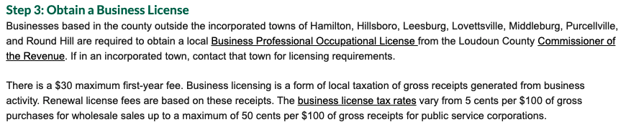
Notify users of fees and charges at the start of task
Tell the user about all charges at the start of a transaction including typical values.
Any conditions and terms should also be available at the start of the transaction in easy language.
Notes:
Use:
Clearly stated charges. Users are aware of all charges and can make an informed decision when they decide to purchase an item and put it in a shopping cart.
Clearly stated of ranges of possible charges. For items with shipping charges that vary, list the range of shipping charges and the issues that change the rate, along with a link to where more details can be found. For example, weight and speed of shipping may impact your shipping fees which can be between $4 and $400 depending on location.
There are no surprise conditions.
Avoid:
Final transactions that include new charges or hidden fees, that result in higher-than-expected total charges.
Final transactions that include conditions of purchase that are not clear to users from the beginning of the task.
Transactions that contain charges or conditions that the user did not know about until they had invested a lot of effort into the sale.

Slide 19
Clearly state the results and disadvantages of actions, options, and selections
When presenting users with actions and selections, clearly explain the benefits, risks and consequences of each option. This includes any:
changes from what the user asked for,
disadvantages from the standard product or offering,
features that may be a risk to users wellbeing or finances.
Notes:
Clear lists of what is included and what is not included. For example:
When choosing an airline ticket. Next to each option, there is a clear list of what is included.
Warnings about any changes or risks. For example:
When choosing an airline ticket, if a ticket option is to a different destination or there is another unusual action or change that could be unwanted or have risks, the user is asked to confirm the change.
Avoid:
Details that are not clear when the user selects an option.
For example: Meal options from an online menu have fun names. The meal contents, side items, allergy information and ability to customize each option is not visible until two steps later in the process. A customer must go several screens down on each item in order to make a decision.
Changing items from the original request without warning the user.
Risks to the user without warnings.

Slide 20
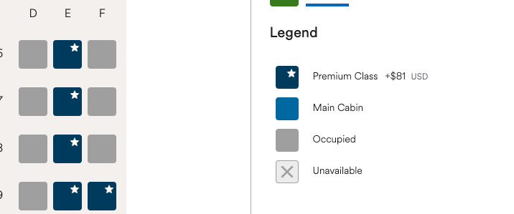

Examples from Alaska Airlines

Slide 21
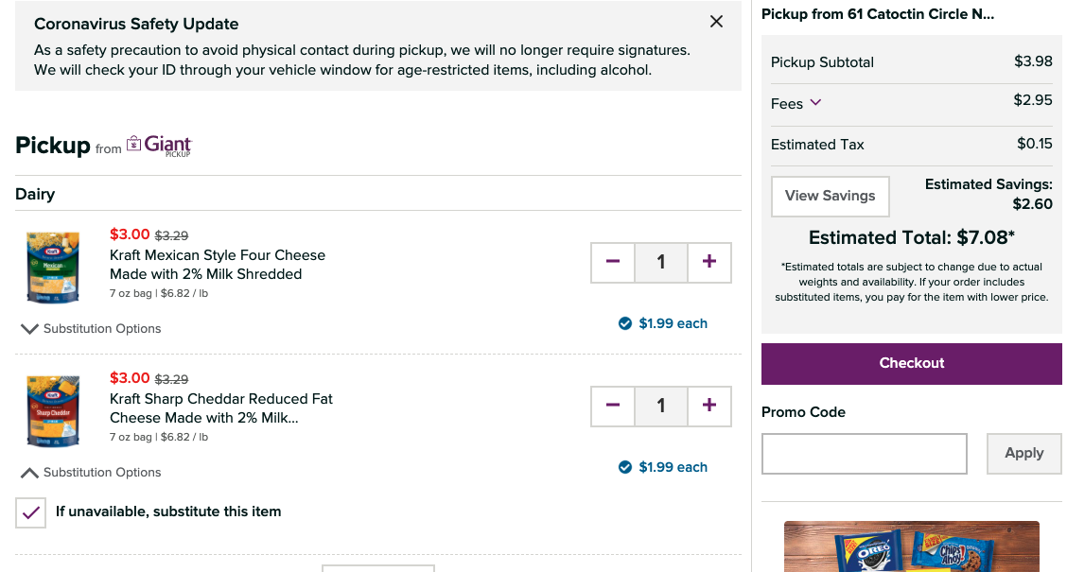
Example from Giant Food Delivery

Slide 22

Jonathan: Therapist with Dyscalculia
Problem: It says there is a meeting at 15.34 UTH. Now is lunch time. Did I miss it?
Works well: There is a line marker showing what time of day it is now, so I can see the meeting is soon.
Sample User Needs:
Provide alternatives for numerical concepts
Provide a login that does not rely on memory or other cognitive skills
Allow the user a simple, single step, login
Provide a login alternative with less words
Notes:
His Story
Jonathan is a massage therapist with dyscalculia.
Although he is very intelligent in other areas, he has trouble working with numbers and needs to count on his fingers to add very basic sums.
He struggles with concepts like “greater than” and “less than” and understanding how numbers are related to each other, especially ones that end in a series of zeros such as 10, 100, 1000, etc.
It’s hard for him to follow the logic behind mathematical concepts and to do everyday tasks that involve numbers or quantities, like measuring ingredients in a recipe or paying for things in cash.

Slide 23
Provide alternatives for numbers / numerical concepts
Provide a description or representation for numerical content such as:
size
quantity
distance
Time
date
temperature
positive/negative
calculations
sequencing
percentages

Slide 24

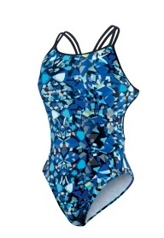
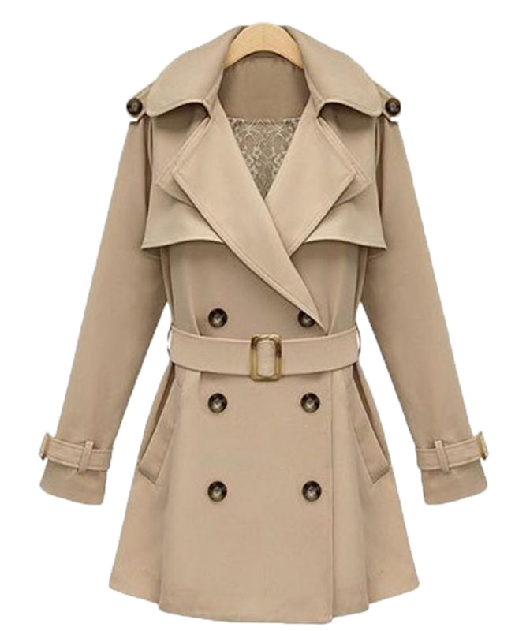

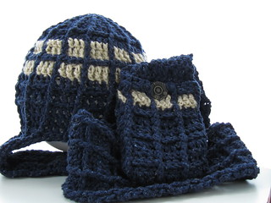
How warm or cold is 272 Kelvin?
272 K | 283 K | 294 K | 305 K

Slide 25

Kwame: A Traumatic Brain Injury Survivor
Problem: I got lost making a shopping order and I wanted to go back to the previous step. I hit the back button on the browser navigation bar and it reloaded the home page. I had to start all over again.
Works well: There is a clear back button on each step and when I use the browser back button it also works.
Sample User Needs:
Provide Search
Make the site hierarchy easy to understand and navigate
Use a clear and understandable page structure
Help the user stay safe
Avoid too much content
Provide information so a user can complete and prepare for a task
Make short critical paths
Make the purpose of your page clear
Notes:
His Story
Jonathan is a massage therapist with dyscalculia.
Although he is very intelligent in other areas, he has trouble working with numbers and needs to count on his fingers to add very basic sums.
He struggles with concepts like “greater than” and “less than” and understanding how numbers are related to each other, especially ones that end in a series of zeros such as 10, 100, 1000, etc.
It’s hard for him to follow the logic behind mathematical concepts and to do everyday tasks that involve numbers or quantities, like measuring ingredients in a recipe or paying for things in cash.

Slide 26
Provide information so a user can complete and prepare for a task
Before a user performs a task consisting of multiple steps, ensure they have an estimate of the amount of effort required to complete the task:
the time it might take,
details of any resources needed to perform the task, and
overview of the process and next step.
Once the user starts the task, ensure the user clearly understands when the task is still “in-process” and when it has been completed.
Notes:
Credit card, drivers license, necessary information
Visual cues when a user starts a task.
An overview of the process including the time it might take, and any resources needed. For example:
Before the user begins to book an airline ticket, a message is presented, “The average time for booking an airline ticket is 15-30 minutes. You will need your travel dates, the number of travelers, and each travelers’ passport to complete this process.”

Slide 27
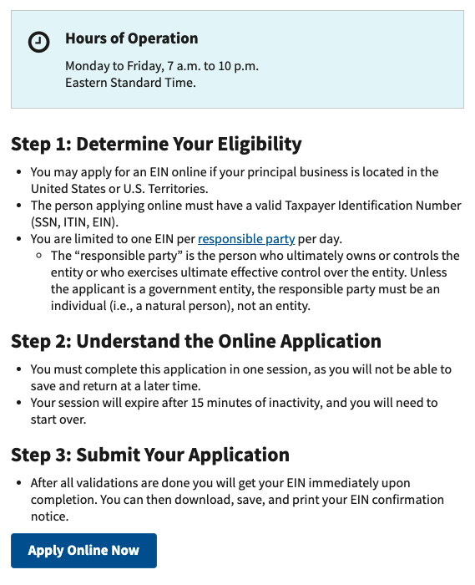
Example: EIN Application

Slide 28

Maria: A User who has Memory Loss
Problem: When there are lots of buttons or menu items I often make mistakes and press the wrong ones and end up getting frustrated and wasting time.
Works well: I like web sites that allow me to work through a series of instructions and edit boxes one after the other with clear buttons moving me to the next stage.
Sample Design Patterns:
Make the purpose of your page clear
Make it easy to find the most important tasks and features of the site
Make each step clear
Use icons that help the user
Let users go back
Make it easy to undo form errors
Do not rely on users calculations or memorizing information
Notes:
Her Story
Maria is 50 years old, married, and lives with her family in São Paulo, Brazil.
Maria is beginning to lose her memory but still works part-time for a local company.
Maria needs to use websites to gather information and order products. More modern websites with content that changes when the mouse hovers over it are a nightmare! While ordering business cards (a multi-step process), Maria has difficulty remembering information that she enters into previous screens. On the first step she sees content choices that the process expects her to remember in later screens. Additionally, the prolonged mental stress that she experiences while navigating means it is hard for her to make new memories. Processes that require Maria to remember information from one step to another need to give her the information required, at the exact point of use, otherwise she will not be able to complete the process. Because she has hand/eye coordination difficulties, she also often presses something incorrectly.

Slide 29
Make it easy to find the most important actions and information on the page
Make key content visually stand out. Key content should be visible to users without needing to scroll the page or hover over content. This includes:
critical tasks and the controls needed to complete them,
interactions for critical features (e.g. login forms, send buttons), and
important information (e.g. health warnings or information that can affect safety).
Notes:
Use:
The most important tasks are directly on the main page and in visually distinct boxes. For example, important tasks on a library site might be: searching, signing up for a library card, locating a branch, and reserving a conference room.
The most used features are near the top of the page.
Avoid:
Items that the team wish to promote more prominently placed than the main reason for users coming to the site. For example: A library web site only includes upcoming events on the main page. Users have to click through non obvious links to search for books, signing up for a library card, locating a branch, or reserving a conference room.
Positioning information users are likely to want so they have to scroll, or page down, to find it.

Slide 30
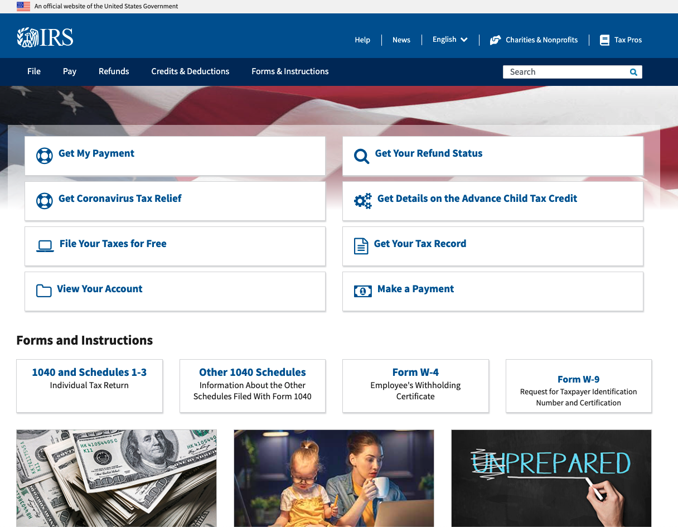
Example: IRS Main Page

Slide 31
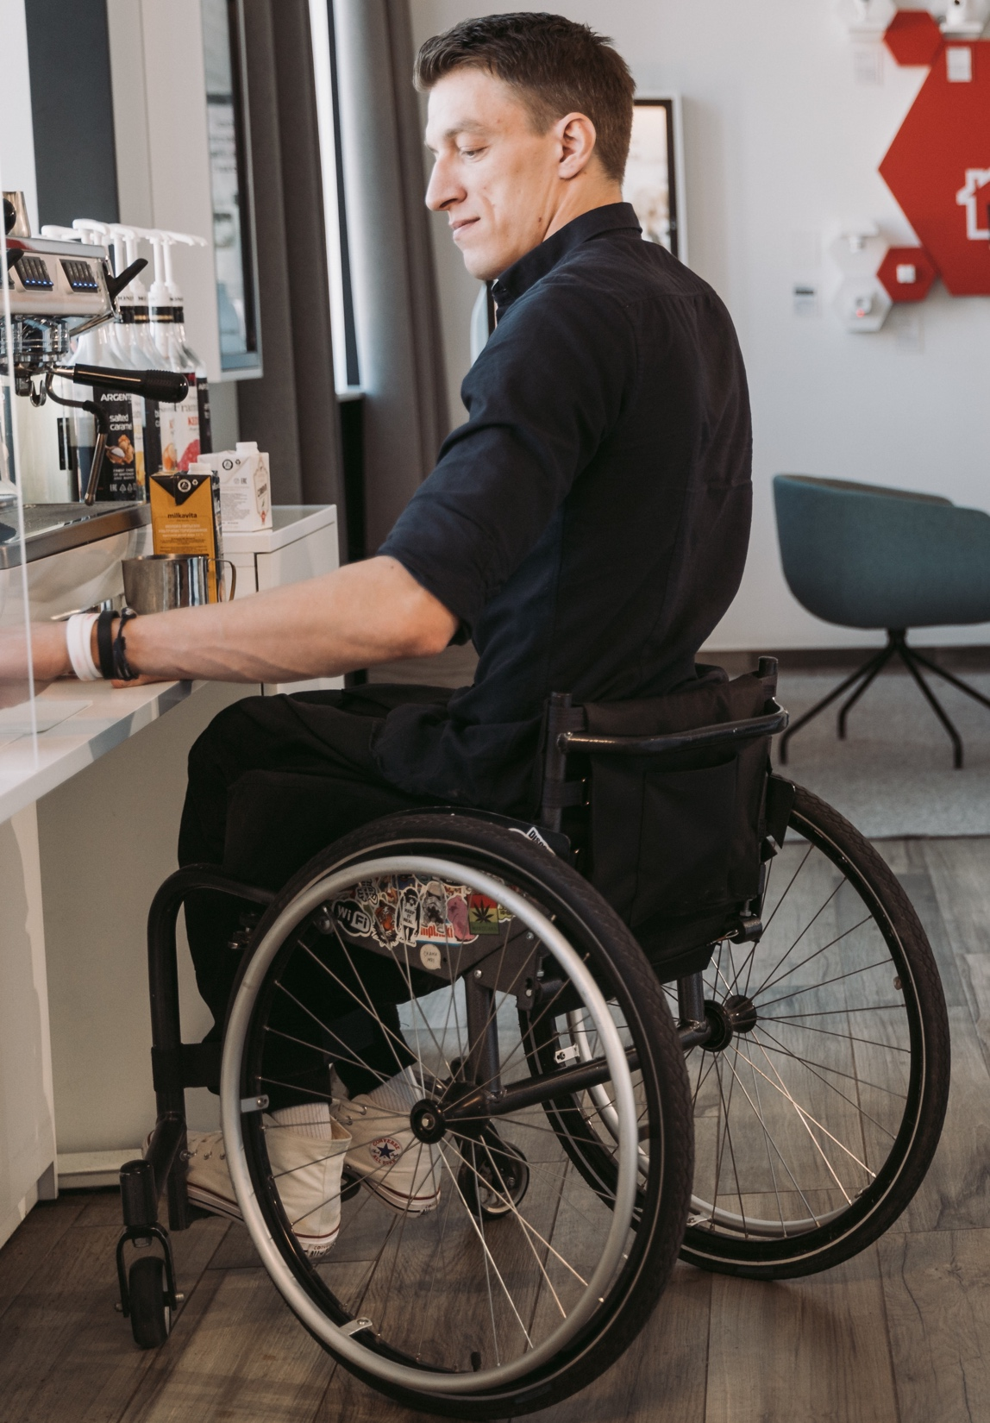
Sam: Librarian who has a Hemiplegia and Aphasia
Problem: Long sentences are hard, too many strange words, and I get lost.
Works well: I like simple short sentences with easy words.
Select Design Patterns:
Use clear words
Use a simple tense and voice
Avoid double negatives or nested clauses
Use literal language
Keep text succinct
Use clear, unambiguous text formatting and punctuation
Explain implied content
Provide help for forms and non-standard controls
Separate each instruction
Notes:
His Story
Sam loved his work as a librarian. He spent his entire life surrounded by books in peaceful places where he could research his love for history.
In recent years, he enjoyed using the web to explore how other people around the world saw the history of his own country and the changing views on famous people from the past. Now he is depressed and very frustrated due to a recent stroke.
The right side of his body is paralyzed.
He also has difficulty having conversations with friends and family due to aphasia. To him this means that some of his words are muddled and his understanding is not always as clear as it has been.
Worst of all, he cannot read as fluently as he has in the past. One-handed typing is slow and he finds his word finding abilities often fail him.
Hemiplegia – partial paralysis Aphasia - loss of ability to understand or express speech, caused by brain damage.

Slide 32
Make Each Step Clear
In instructions, separate each step. State each step clearly. This includes:
including all steps, even those you think are “obvious”,
using numbers and lists can also help,
providing complex instructions in an if/then table, which can be easier to follow, or
using friendly graphics can help make instructions less scary.
Notes:
Use:
Bullet points to separate each step.
An if/then table to separate steps based on conditions.
Avoid
More than one step in the same block of text without separation. For example:
If you want to work in programing, write to programing@example.com with a resume and sample code that you wrote. If you want to work in design, write to design@example.com with a resume and sample pages.

Slide 33
Example: Application Process
This:
If | Then
If you want to work in programing: | Make a resume. Get some sample code that you wrote. Send them to programing@example.com.
If you want to work in design: | Make a resume. Get some sample pages that you designed. Send them to design@example.com.
Not:
If you want to work in programing, write to programing@example.com with a resume and sample code that you wrote. If you want to work in design, write to design@example.com with a resume and sample pages.

Slide 34
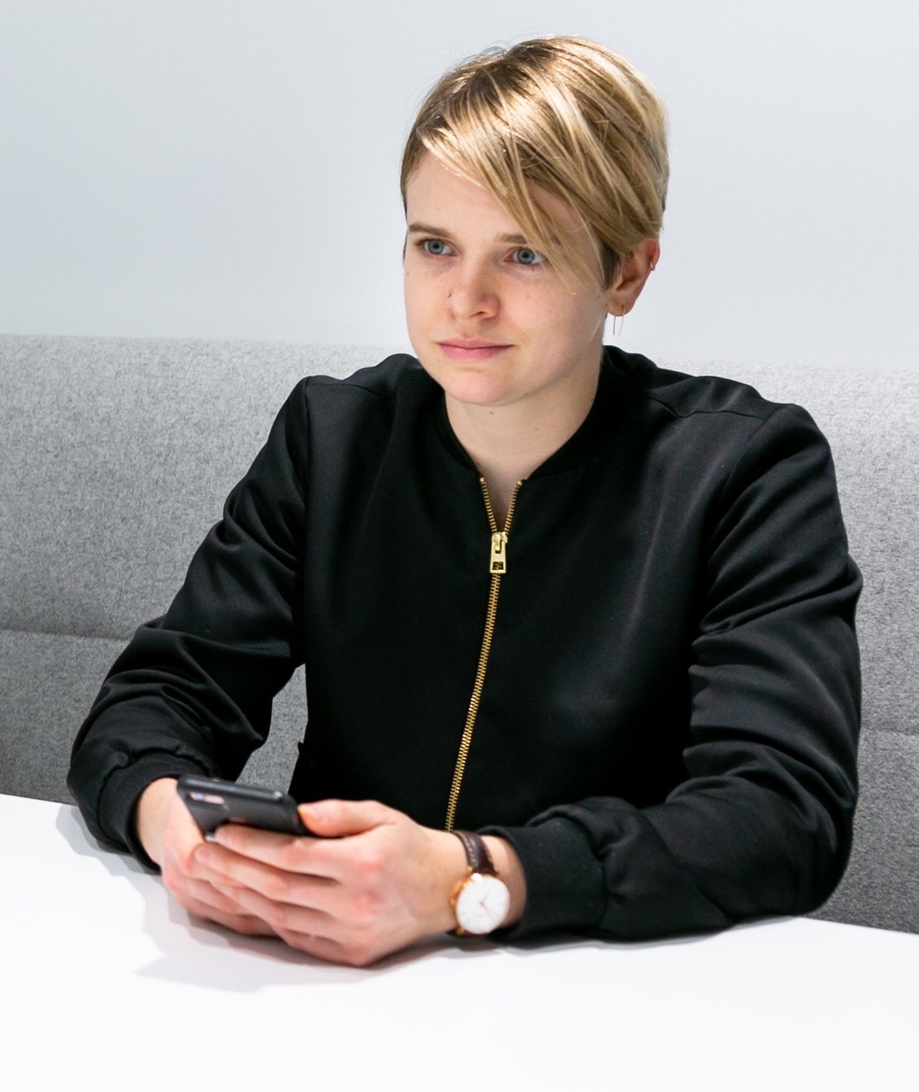
Tal: Student with Dyslexia, Impaired Eye Hand Coordination
Problem: As a slow reader it takes me ages to read through badly structured text and I often miss important information.
Works well: The newsletter has headings so I can find the important information quickly.
Sample User Needs:
Make it easy to find the most important tasks and features of the site
Make it easy to find the most important actions and information on the page
Provide a login that does not rely on memory or other cognitive skills
Allow the user a simple, single step, login
Provide a login alternative with less words
Notes:
Their Story
Tal has been a student in Israel for the past year. Tal's Fashion Design course is challenging but fun.
Tal loves the creative aspect of the diploma where there is more drawing than writing.
Tal has moderate dyslexia, resulting in times when it is hard to cope with complex text.
Tal sometimes finds it a challenge working out how words are pronounced when they have many syllables. This can make it hard for Tal to grasp the meaning of some paragraphs.
They often have to reread content.
Tal has several projects to complete as part of the Fashion Design portfolio requirements. The one that worries Tal most involves a written assignment to research post-war fashions and their impact on today's designs.

Slide 35
Provide a Login that Does Not Rely on Memory or Other Cognitive Skills
Users can login, register, and reset credentials, without having more cognitive abilities then they need to use a simple web page.
They do not have to:
memorize character strings,
perform calculations,
copy content,
answer puzzles,
reliably reproduce gestures, or
recognize characters presented on screen, and then enter them into an input field.
Notes:
Use:
Web Authentication: An API for accessing Public Key Credentials [webauthn-2].
Single Sign-on (SSO) that allow users to access many sites with a single login (federated login).
Two step authentication with Bluetooth links (no copying).
Quick Response Codes (QR Code).
Avoid:
Using two-step authentication that requires copying.
Using a password and not allowing pasting into the field.

Slide 36

Yuki: A Yoga Teacher who has AD(H)D
Problem: As a slow reader it takes me ages to read through badly structured text and I often miss important information.
Works well: The newsletter has headings so I can find the important information quickly.
Sample User Needs:
Break media into chunks
Provide summary of long documents and media
Limit interruptions
Avoid too much content
Provide information so a user can complete and prepare for a task
Make short critical paths
Notes:
Her Story
Yuki found concentrating at school difficult.
When she got into college and started taking a course in business studies life became even more stressful. She knew she could cope with the studies, but never seemed to get her work completed on time.
She found it hard to start a report and even to create a plan for a project.
When working with others she always had good ideas but somehow they were never taken up. She became frustrated, often failing to keep her feelings in check.
Luckily, a tutor suggested she look for help.
When a psychologist mentioned Attention Deficit Hyperactive Disorder or AD(H)D, Yuki was relieved to have a reason for her planning and organizational difficulties and other executive functions.
She did not want to draw attention to her difficulties, but knowing what caused the challenges helped her find solutions. She learnt that if she could make use of her constantly active brain and body as well as manage her time better, she could turn her hobby into a very successful Yoga business.

Slide 37
Break Media into Chunks
Provide a logical organization and structure that is easy to navigate.
Divide long pieces of media into segments that are:
logical,
short,
labeled,
easy to identify, and
easy to reach or jump to
Notes:
Use:
Media that is divided into short logical segments. Each section is labeled and easy to get to. For example: A 30-minute video is divided into 5 sections, each with a descriptive link to play from that point onwards.
Avoid:
Media that is not divided into segments. For example: A 30-minute video contains no subdivisions or descriptions of sections. A user has to play it from the beginning or guess starting locations within the video.
Media sections that are not labeled.
Media sections that are not linked to in the summary or table of contents.

Slide 38
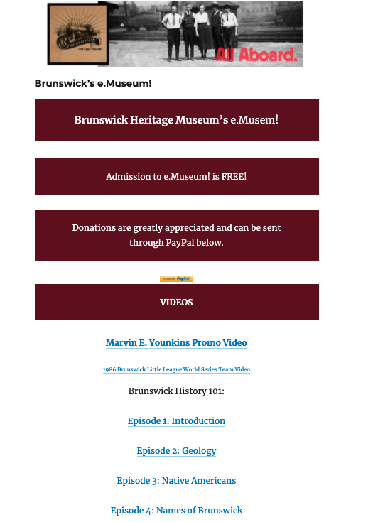
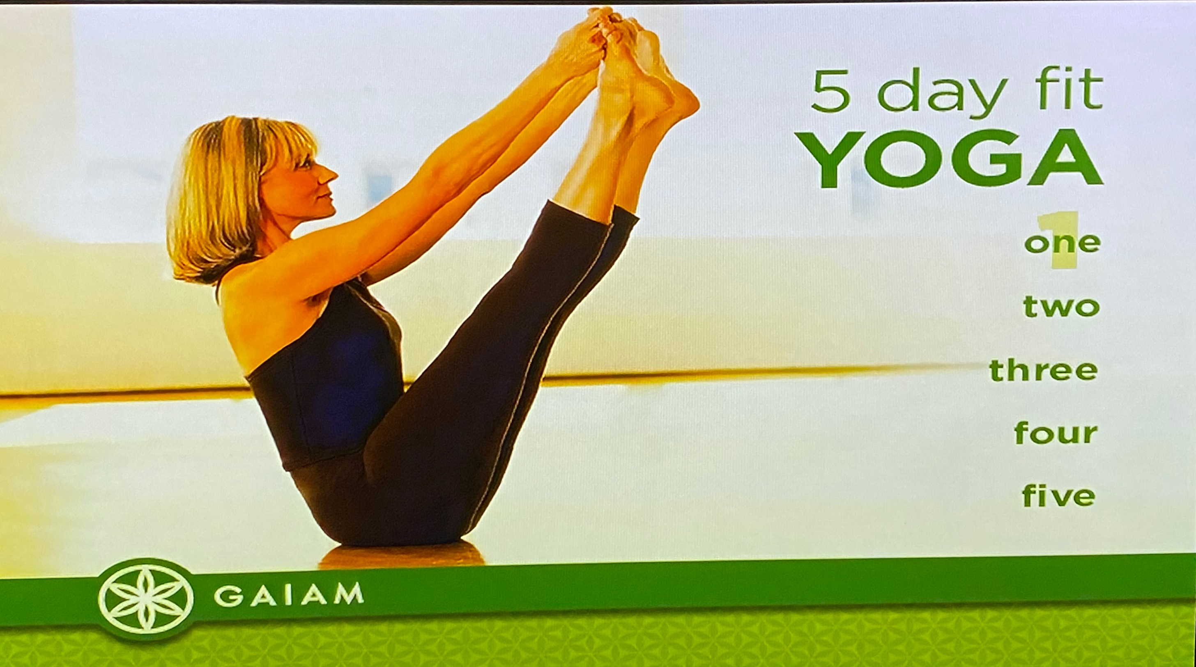
Examples: Brunswick Museum and Yoga Video

Slide 39
Plain Language / Clear Language
Key parts of plain language
Use common words – define uncommon words
Use a simple tense and voice
Avoid double negatives
Avoid nested clauses
Keep text succinct
Use lists for list content
References:
Making Content Usable - Use Clear and Understandable Content
PlainLanguage.gov

Slide 40
Which Do YOU understand faster?
A Landlord’s Right to Deduct. When a tenant moves into a rental property, he or she will pay the landlord a security deposit. Depending on the jurisdiction, this deposit will be returned to the tenant within a specific time period at the cessation of the lease term, as long as the tenant follows all the terms and tenants of the lease agreement or contract. Select links below to read the laws that pertain to your situation.
Your landlord must follow the law.
Your landlord can only use your security deposit (promise money), for certain things, such as unpaid rent (rent that you owe) and to fix things that you damage.
Your landlord must return your security deposit (promise money) to you by a clear date. This is usually 30 days after you leave the apartment.
Notes:
Other examples:
Your stocks went up this month. Vs Over the last month, we saw your stocks increasing
Time is not unlimited or You have limited time

Slide 41
Next Steps
Get a copy of these slides
Check out the references
Making Content Usable
PlainLanguage.gov
Try out new ideas, get feedback, and iterate
Include individuals with cognitive and learning disabilities in user testing

Slide 42
Questions?
Contact Email
rmontgomery@loc.gov

